Slide 1
Unity Basics
Basic help for creating your game

Slide 2
Overall Navigation
Introduction to Interface (Slide # 4 )
Basic Movement
Basic Camera + Lighting
Asset Store
Materials and Textures
Particle System
Terrain
Basic codes
Triggers

Slide 3
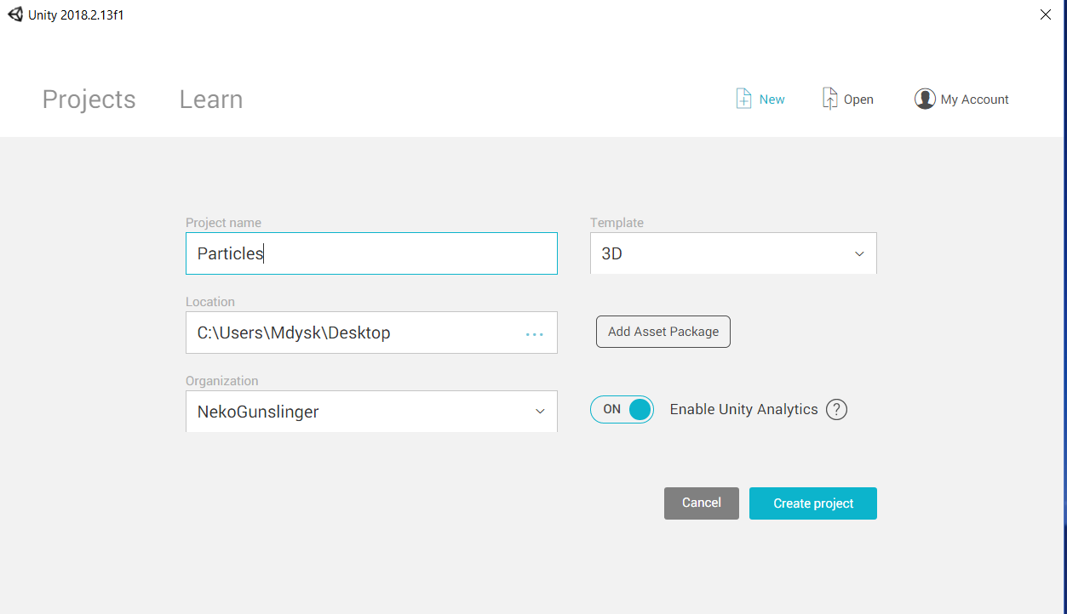
Creating a New project
Just hit "New" on the top right corner of screen.
Name your project
Make sure it is "3D"
Pick locaton
Hit "Create Project"

Slide 4
Interface key features
Scene (Slide 5)
Hierarchy (Slide 6)
Inspector (Slide 7)
Assets (Slide 8)

Slide 5
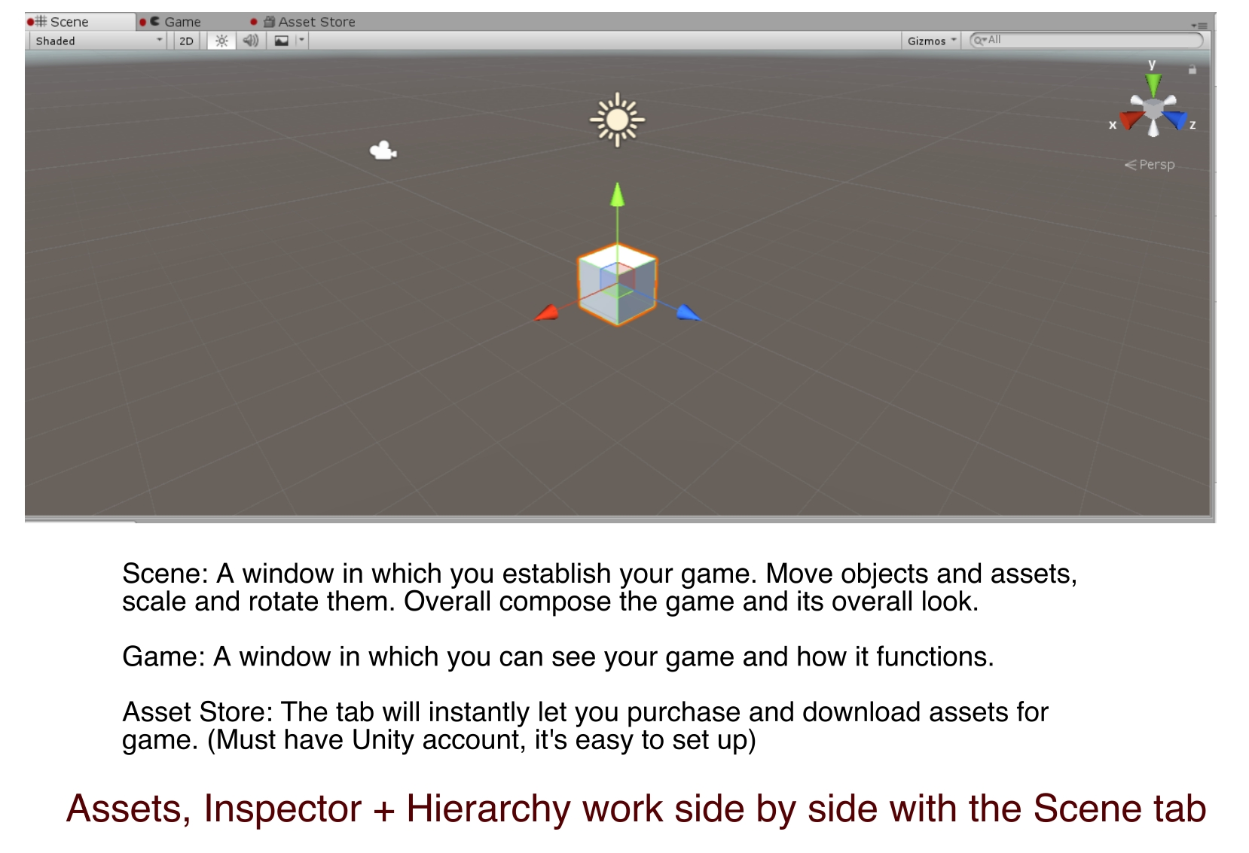
Scene

Slide 6
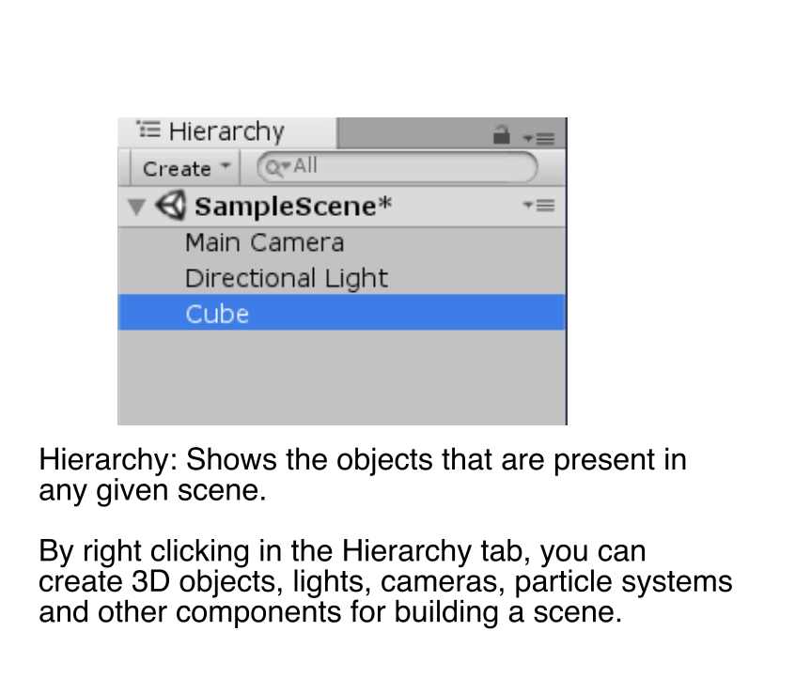
Hierarchy

Slide 7
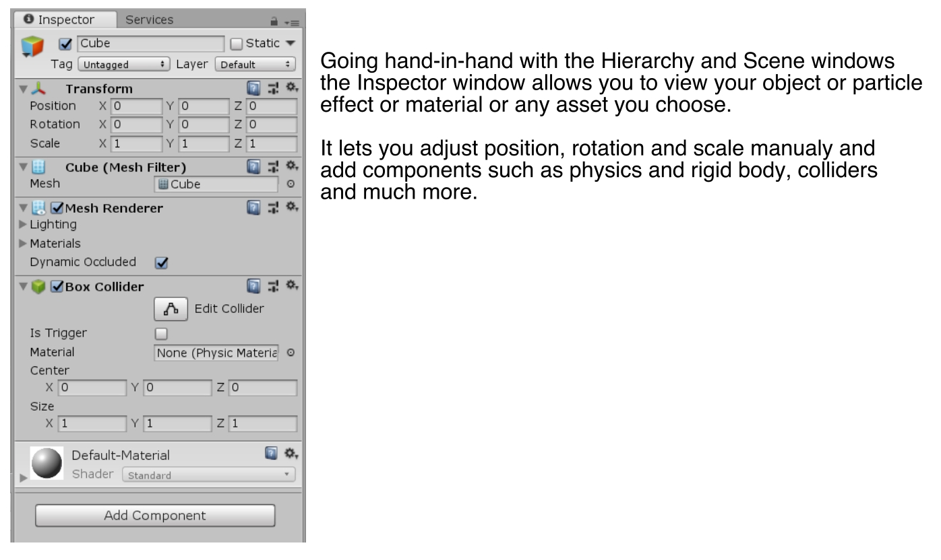
Inspector

Slide 8
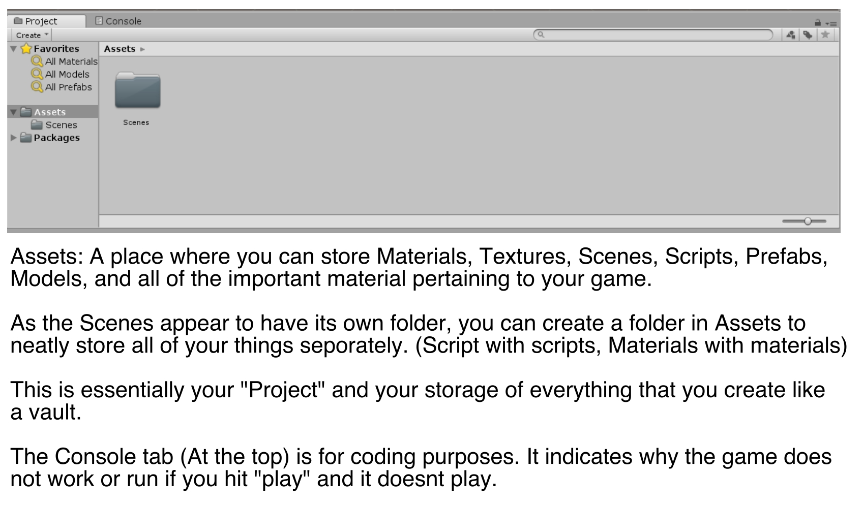
Assets

Slide 9
Basic Movement
Navigating in Unity
Creating an Object
Properties
Rotation and Scale

Slide 10
Navigation
Optimal to use a mouse.
Left click: Selects objects.
Scrolling Wheel: Zooms; if clicked navigates in the world.
Right click: rotates in the world

Slide 11
Creating an object
Hierarchy tab: Right click, select 3D object > Cube (Or any other object you wish to place)
It will be placed into your map. You can view its properties in the inspector

Slide 12
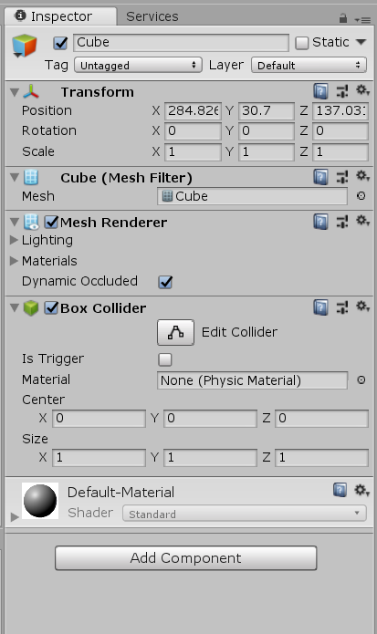
Properties
You can manually change the properties through the inspector tab, such as scale, rotation, and position.
Box Collider gives the object “walls” and makes it solid. Can also be set as “trigger” so that touching it will cause something to happen
Add component button will allow you to add more such as physics or audio components.

Slide 13
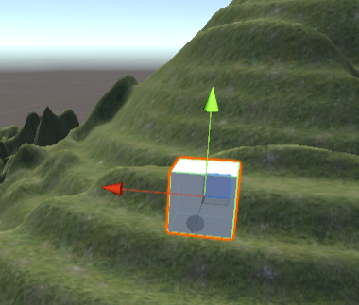
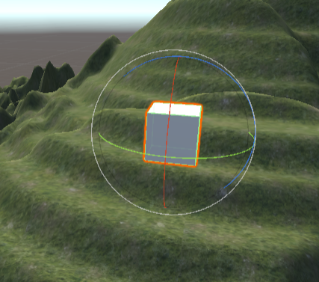
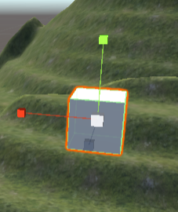
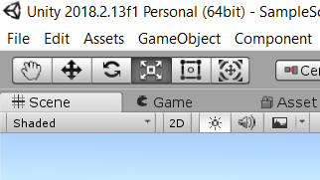
Move, Rotation and Scale
Move
Rotate
Scale
These buttons on the top of the Unity screen (after the hand and before the square
With a circle in the middle) allow you to move the cube, rotate and scale it aside
From using the Inspector Window.

Slide 14
Basic Camera and Light
Camera Control
Camera Options
Light Control
Light Options

Slide 15
Asset Store
Accessing Unity Asset Store
Finding Assets
Downloading Content
Placing into Unity

Slide 16
Materials and Textures
Creating Particle Systems (Slide 5)
Adjusting Elements
Refining Particle system
Customizing with Maps/textures

Slide 17
Particle System
Creating Particle Systems (Slide 5)
Adjusting Elements
Refining Particle system
Customizing with Maps/textures

Slide 18
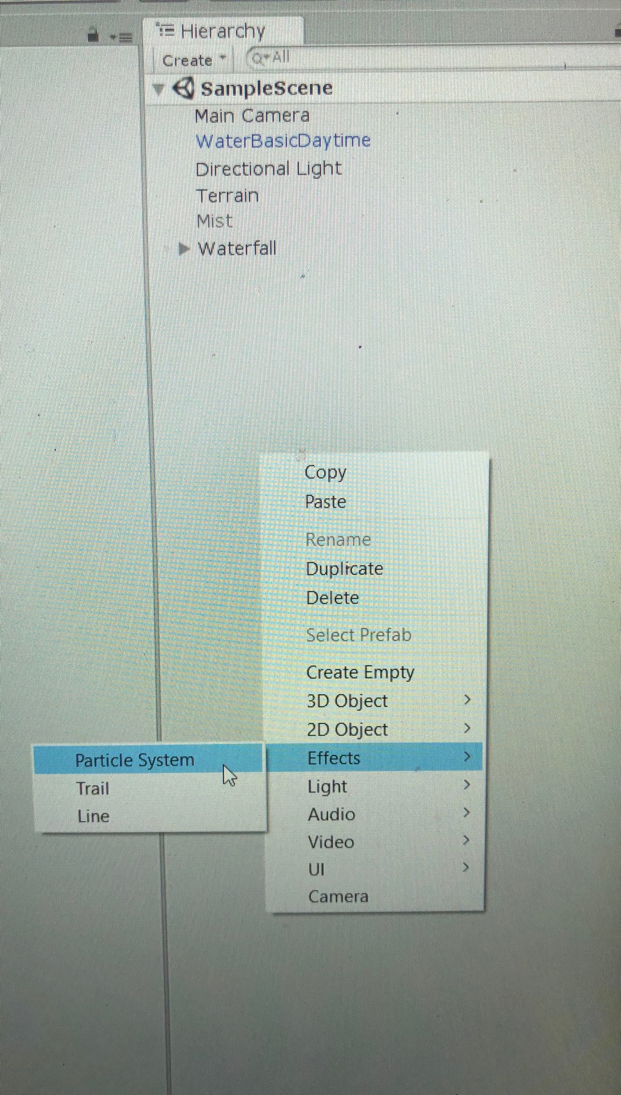
Creating a Particle System
Right click in the Hierarchy window:
Effects > Particle System

Slide 19
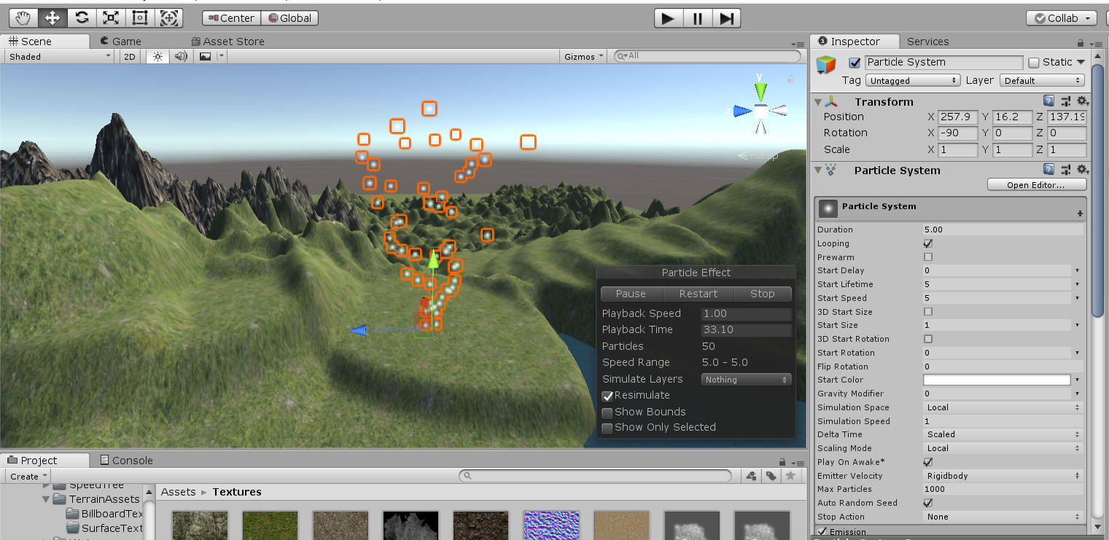
Adjusting the Particle system
Now that the particle system was created, time to play around with the parameters in the inspector window.

Slide 20
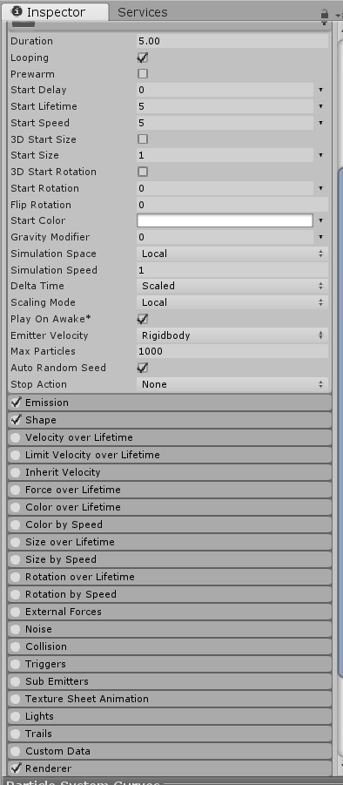
Particle parameters
Click on any parameter to expand it
Check mark to enable any parameter.

Slide 21
Basic Coding
Creating File
Coding programs
Basic functions
Basic Coding elements

Slide 23
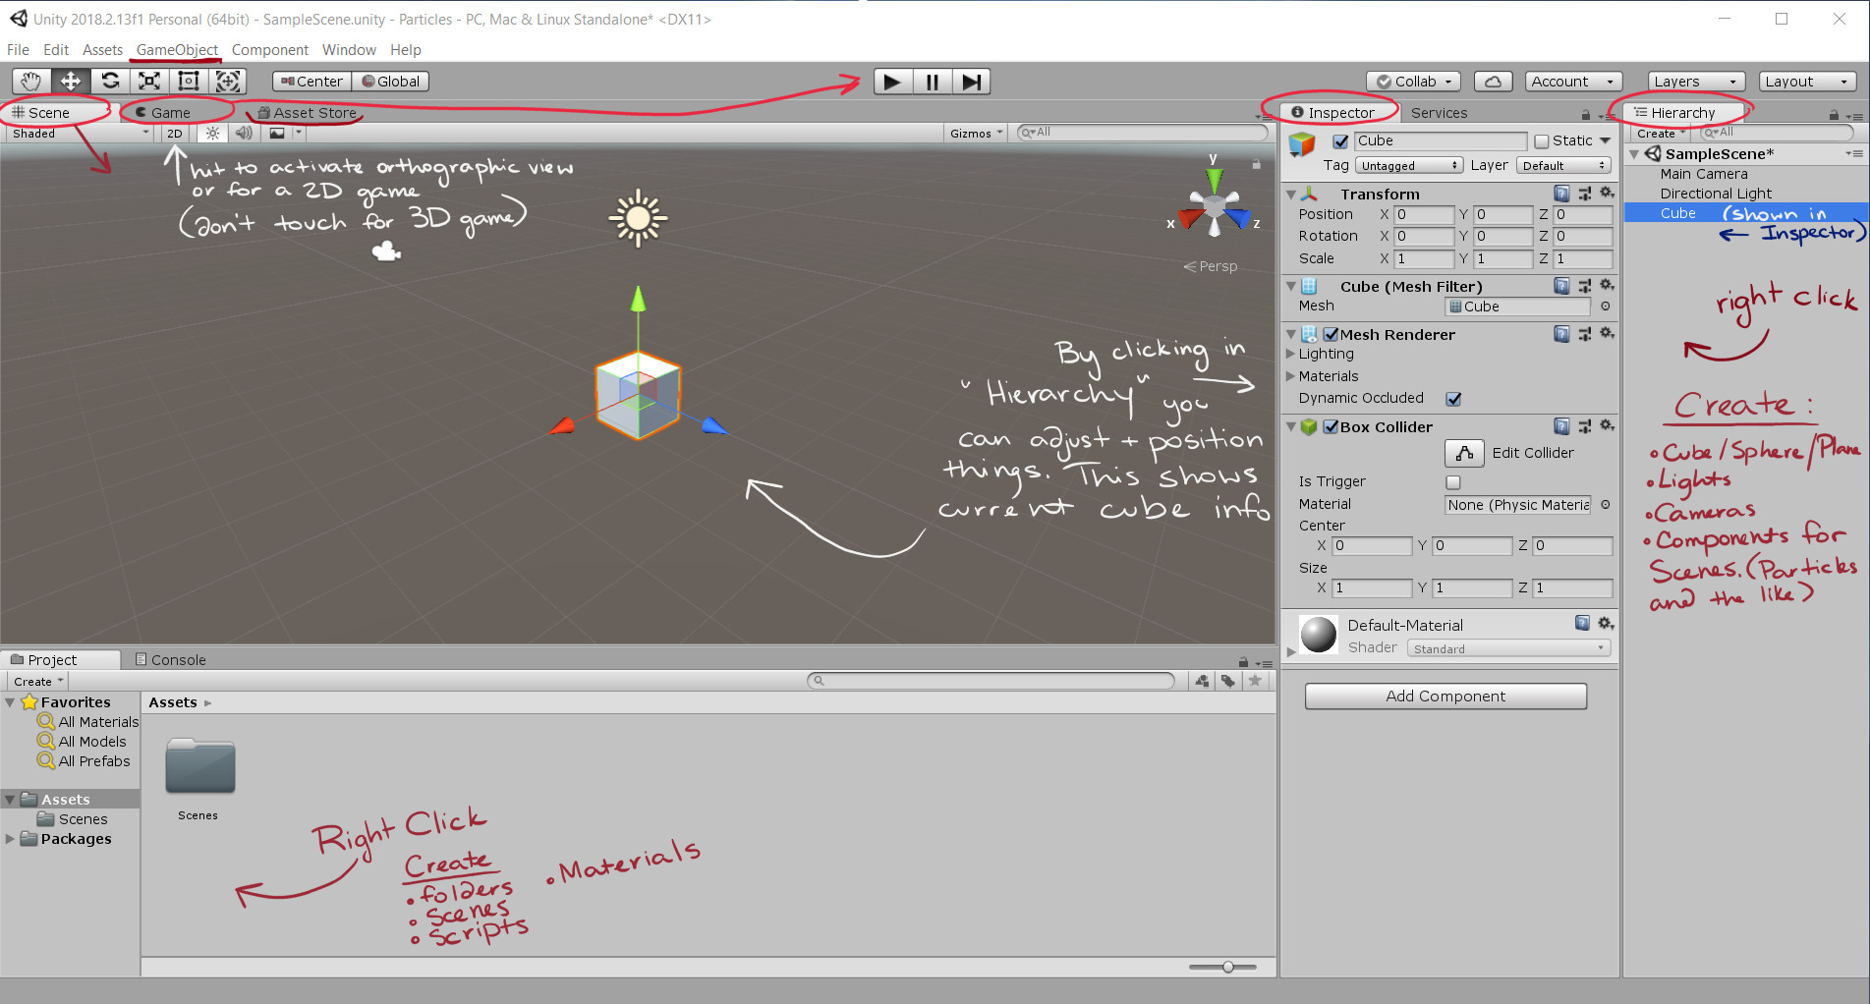
Interface

